Slide 1
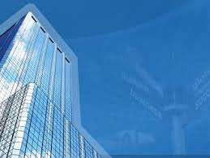






Slide 2


Contents:
Building structure.
Non building structure.
classification of buildings;
-> Based on occupancy.
-> Based on type of construction.

Slide 3

Building structure:
A building structure is a man-made structure with a roof and walls standing more or less permanently in one place, such as a house or factory.

Slide 4
Non Building Structure:
A non building structure, also referred to simply as a structure, refers to any body or system of connected parts used to support a load that was not designed for continuous human occupancy.
A non building structure, also referred to simply as a structure, refers to any body or system of connected parts used to support a load that was not designed for continuous human occupancy.
e.g. overpasses , bridges , towers.

Slide 5
Buildings classification
Buildings are classified into two categories.
  Based on the occupancy.
  Based on the type of construction

Slide 6





Buildings classified, based on the occupancy:
Every building or portion of land shall be classified according to its use or the character of its occupancy. They are categorized into the following types.
  Agricultural buildings
  Commercial buildings
  Residential buildings
  Educational buildings
  Government buildings
  Industrial buildings
  Military buildings
  Religious buildings
  Transport buildings
  Power plants

Slide 7

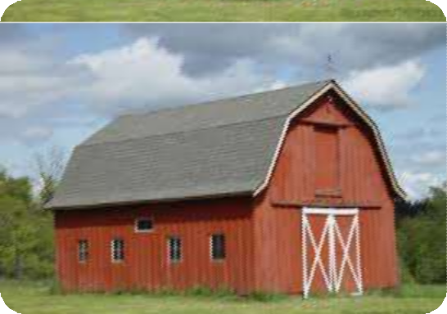
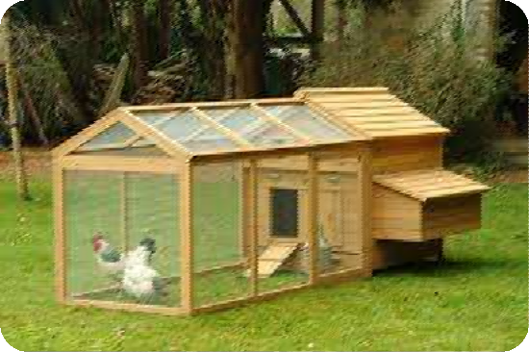
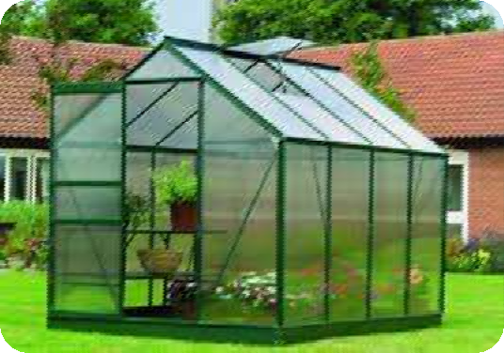



Agricultural buildings:
They are the structures designed for farmers and for agricultural practices, for growing and harvesting crops, and to raise live stock.
barn
Chicken coop
Farm house

Slide 8


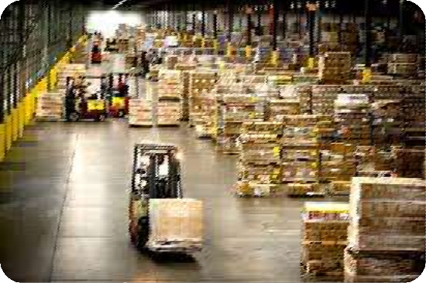

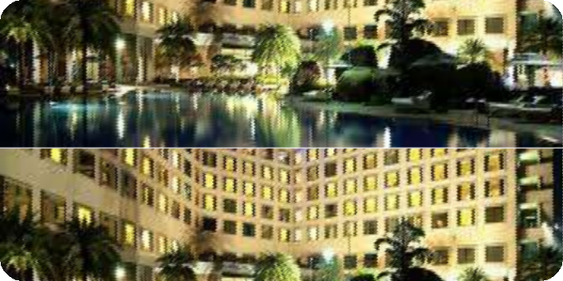



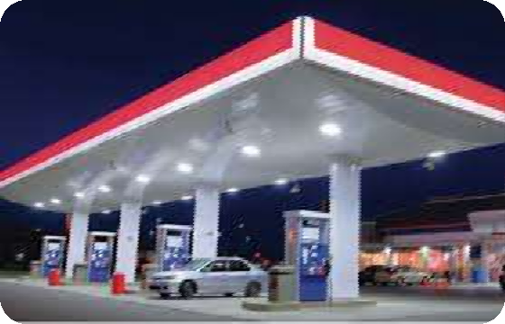
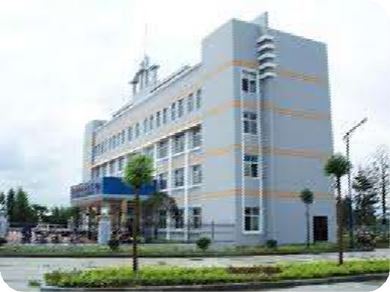


Commercial buildings:
They are the buildings, which are used exclusively for commercial use.
Ware house
Bank
Convention centers
Automobile companies
Gas stations

Slide 9

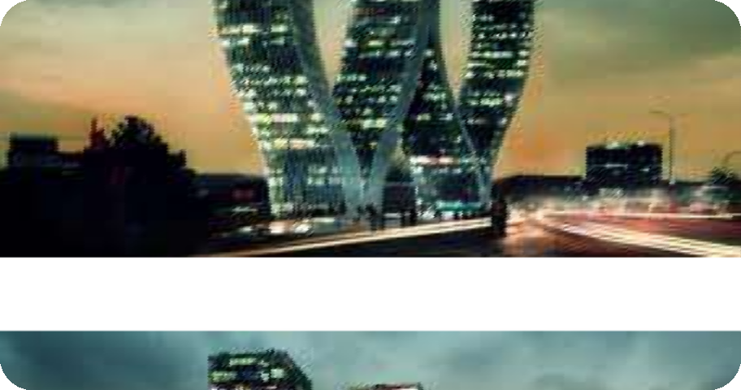


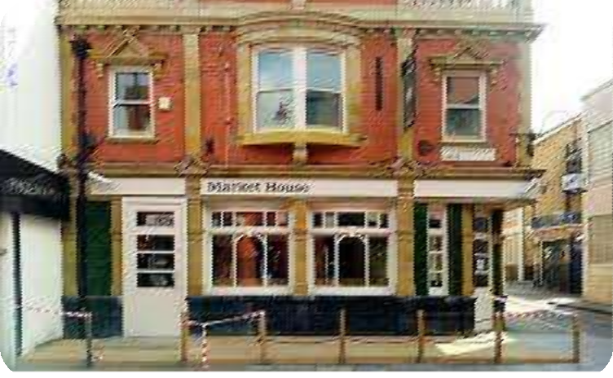
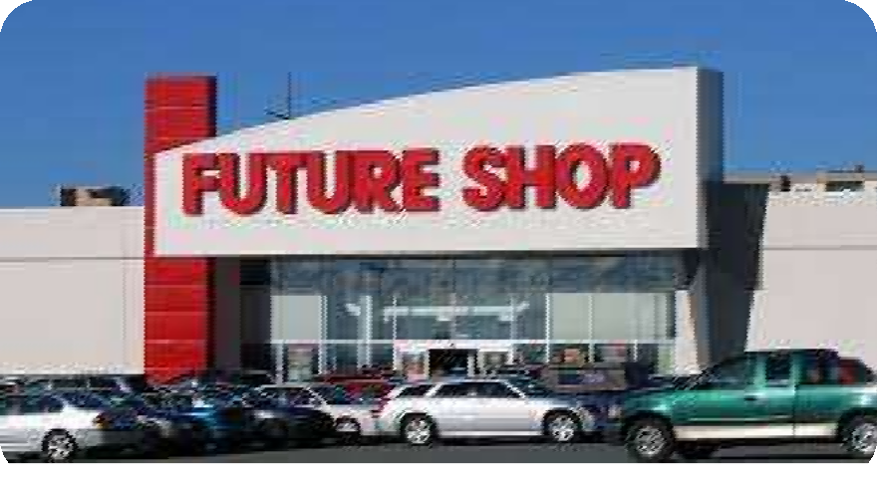


Sky scrapers
Super markets
Market house
Commercial shops

Slide 10

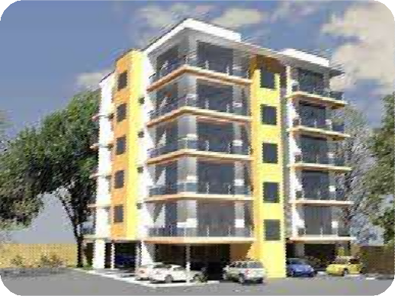
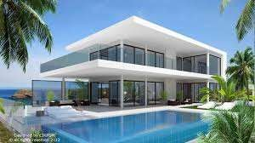

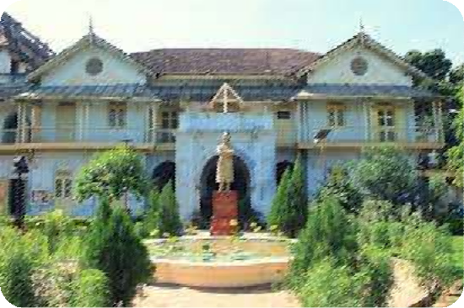
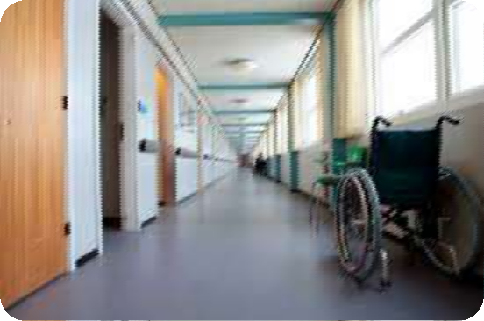


Residential buildings:
A Residential building is that, in which housing predominates, as opposed to industrial and commercial areas. building may vary significantly between, single-family building, multi-family building, or mobile homes.
Villa
Apartment
Bungalow
Nursing home

Slide 11





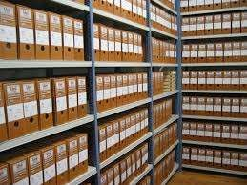


Educational buildings:
This occupancy type shall include any building or portion thereof in which education, training and care are provided to children or adults. This occupancy shall be subdivided as follows :
Museum
School
Archive
library

Slide 12

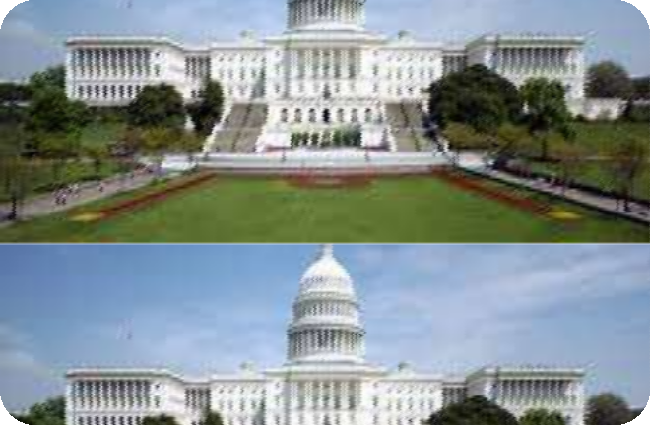
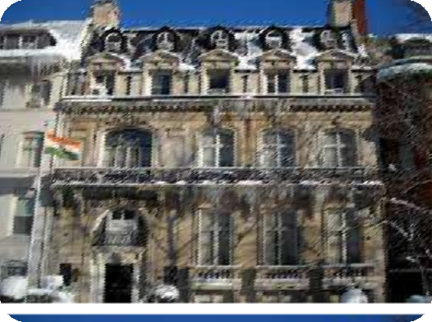
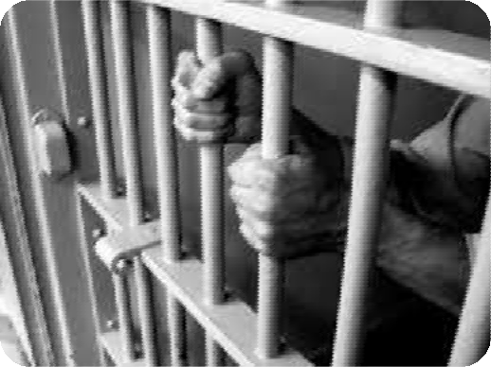



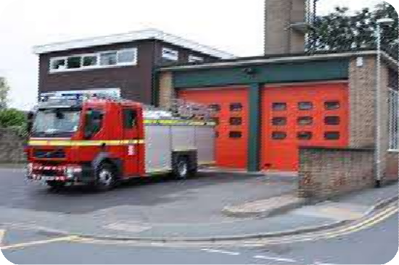
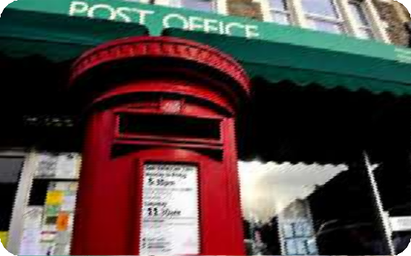


Government buildings:
It is a building that houses a branch of government.
Capitol
Embassy
Prison
Fire station
Post office

Slide 13

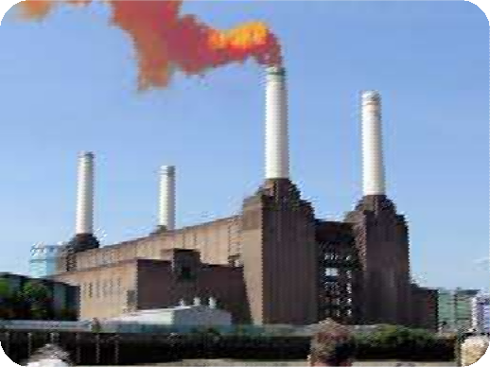
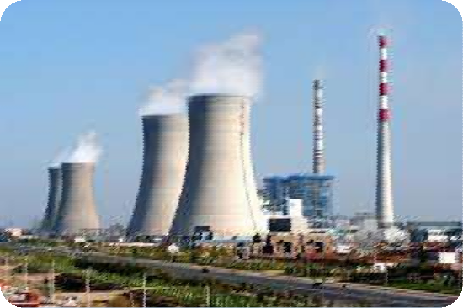

Industrial buildings:
These buildings are designed to house industrial operations and provide the necessary conditions for workers, and for the operation of industrial equipment.
Factory
Power plant

Slide 14

Military buildings:
This building is a structure designed to house the functions, performed by a military unit.
General types include: Administrative Facilities.

Slide 15

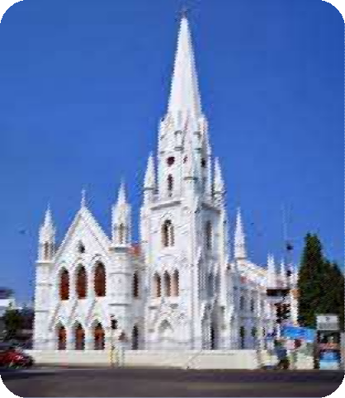
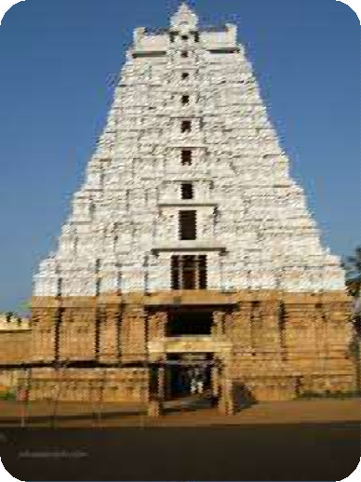
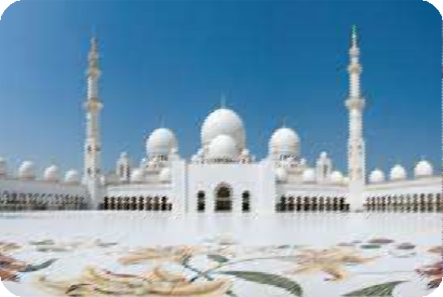



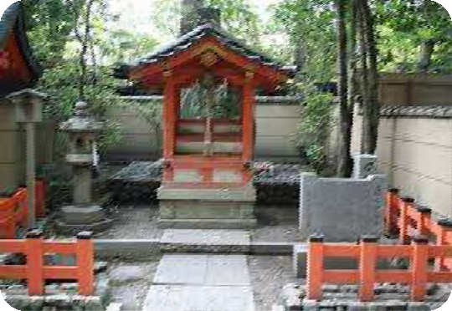



Religious buildings:
These are the buildings for religious purposes, with a large open interior or other monumental qualities. They often have, towers, domes rising above the main structure.
Mosque
Church
Temple
Pyramids
Shrine

Slide 16


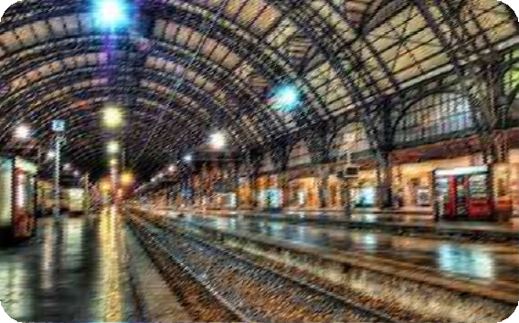
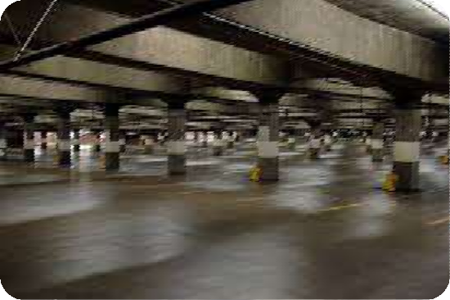



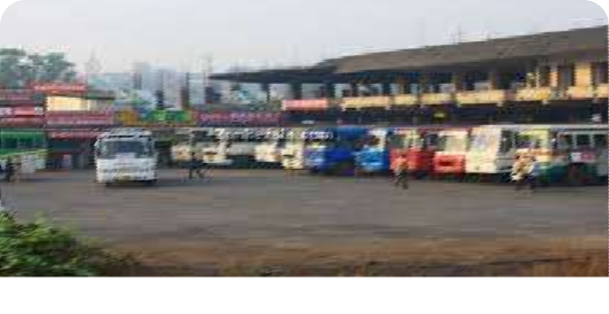

Transport buildings:
This is a structural building which consists of the means of equipment necessary for the movement of passengers or goods on land, water, and air ways.
Air port
Railway station
Parking garage
Bus station

Slide 17

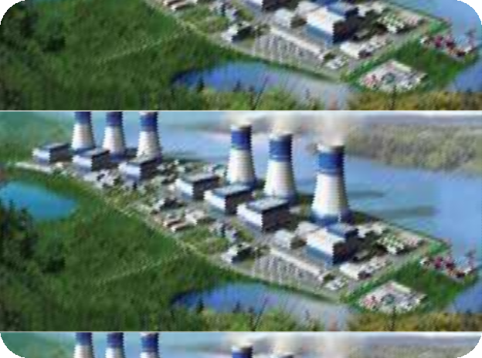
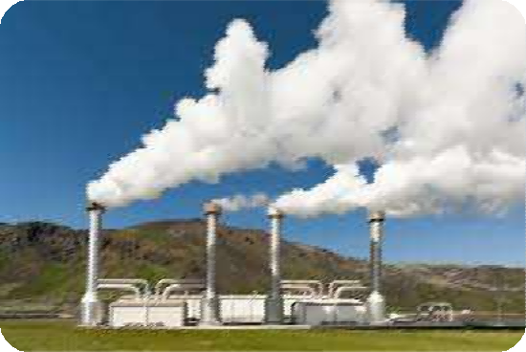
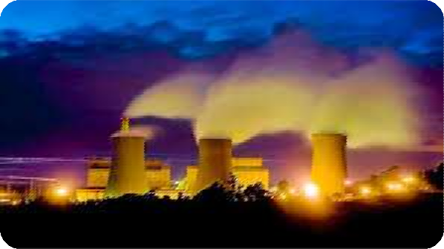



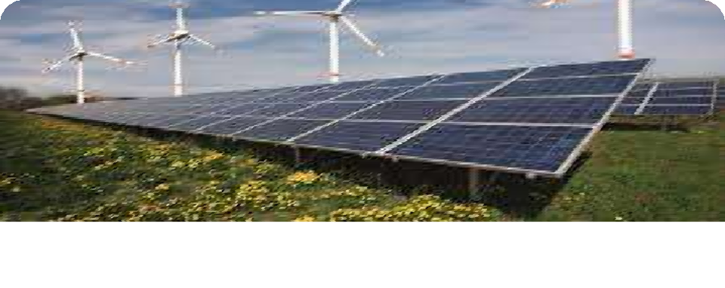

Power stations/power plants:
These buildings serve as the industrial facility to generate electric power.
Geo thermal power plant
Fossil fuel power plant
Nuclear power plant
Renewable energy power station

Slide 18

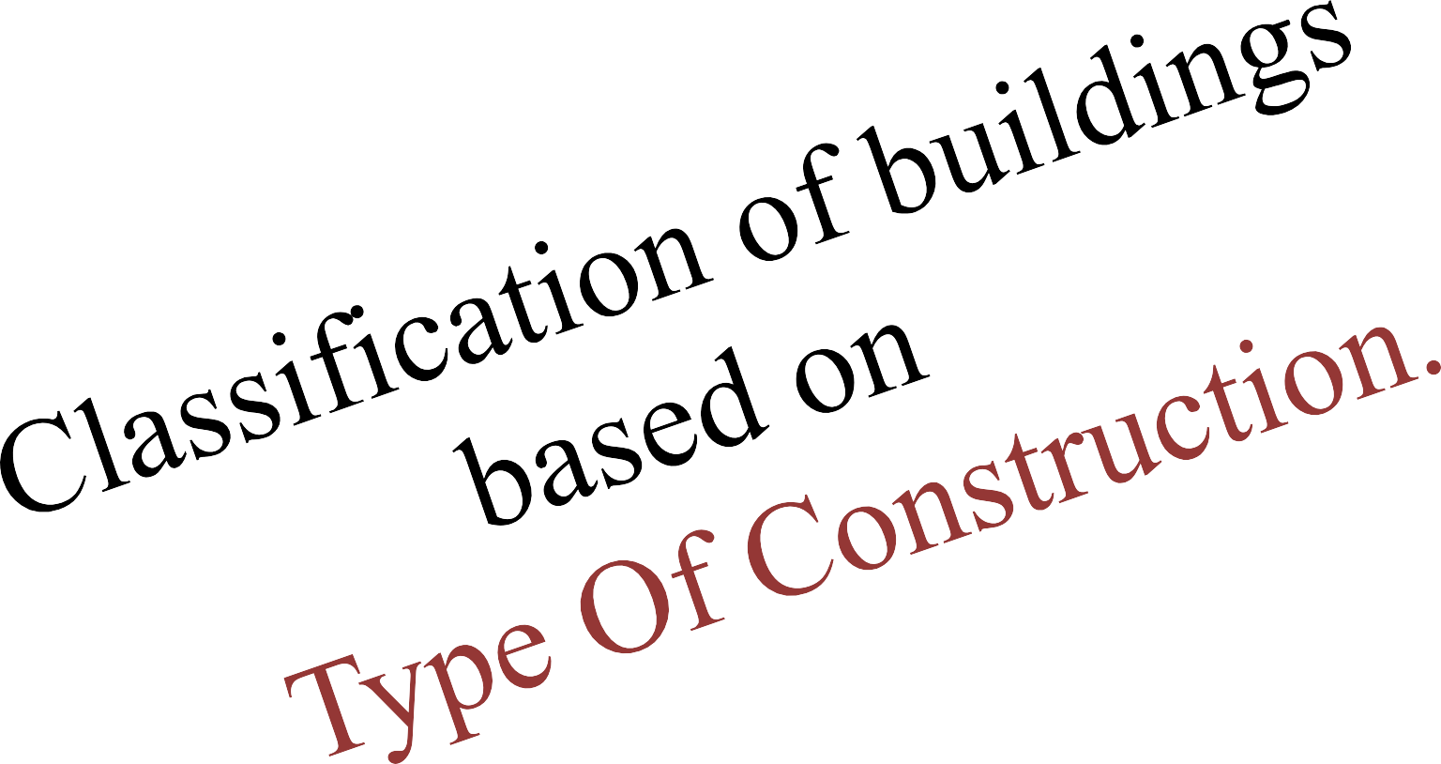

Slide 19

Based on the type of construction, buildings are classified into 5 categories.
  Fire resistive Buildings (Type 1A , 1B) 2)Non–Combustible Buildings (Type 2A, 2B) 3)Ordinary Buildings (Type 3A, 3B)
4)Heavy timber Buildings (Type 4) 5)Wood framed Buildings (Type 5A, 5B)

Slide 20


Fire resistive buildings: (Type 1A, 1B)
These type of buildings are generally high raised, and are usually than 75 feet tall.
They are constructed of concrete and protected steel, (coated with fire resistant material) which are designed to hold fire.
  This type of buildings are generally residential and industrial buildings.

Slide 21
The fire resistance is valid only for a specific time, depending up on the type of construction. Resistive time for Industrial buildings is.
Industrial buildings:
*3 Hr- Exterior Walls.
*3 Hr- Structural Frame.
*2 Hr-Floor/Ceiling assembly.
*1 ½ Hr-Roof Protection.

Slide 22

Residential buildings:
*2 Hr- Exterior Walls.
*2 Hr-Structural frame.
*2 Hr-Ceiling/Floor Separation.
*1 Hr-Ceiling/Roof assembly.
It means that according to the time given above, the building is resistant towards fire, and after the specified time it must be super viewed by the fire control authorities.

Slide 23



Non- combustible buildings:( Type 2A,2B)
These buildings are generally the new buildings and remodels of commercial structures.
The walls and roofs are constructed of non- combustible materials.(i.e. walls are rein forced masonry).
The top of the roofs are covered with light weight concrete etc.

Slide 24








Protected Non-combustible.(common in school buildings)
*1 Hr-Exterior Walls
*1 Hr-Structural Frame
*1 Hr-Floor/Ceiling/Roof Protection
Unprotected Non-combustible.(common in commercial buildings):
These Buildings are constructed of non- combustible materials but these materials have no fire resistance.

Slide 25


Ordinary buildings:(Type 3A,3B)
These buildings may be of old or newer constructions. They have non-combustible walls and wooden roof.
The walls and the roofs are 1 hour fire protected.

Slide 26

Ordinary buildings are of the other type also, which is unprotected combustible. walls are of a wooden roof and the floor assembly is not protected against fire.
These buildings are frequently found in "warehouse“, districts of older cities.
Specifications:
*2 Hr. Exterior Walls
*No fire resistance for structural frame, floors, ceilings, or roofs.

Slide 27




Heavy Timber:(Type 4)
These buildings were most commonly built before 1960. These buildings hold up well under fire conditions.
These buildings are often poorly maintained, or have termites, the weathering issues contributes an earlier-than-expected collapse.

Slide 28

Specifications:
To qualify the structure, all wooden members must have a minimum nominal dimension of 8 inches.
*2 Hr. Exterior Walls
*1 Hr. Structural Frame or Heavy Timber
(Heavy Timber Floor/Ceiling/Roof Assemblies)

Slide 29

Wood framed buildings: (Type 5A,5B)
This type of construction is found in many modern homes. The walls and roofs are made of combustible materials—most commonly wood.
It has a few negative characteristics:
→It is not highly fireproof, as it is made of wood.
→It is not strong enough to resist major wind events such as tornadoes and hurricanes.

Slide 30
Every timber frame home structure is made of a few basic components:
→ Studs are vertical wooden columns within the walls.
→ Joists are the horizontal wooden beams that support the floors.
→ Rafters are the sloping wooden beams that support the roof.
It also has protected wooden frame and unprotected wooden frame.

Slide 31

Protected Wood Frame:
It is Commonly used in the construction of newer apartment buildings; there is no exposed wood visible.
1 Hr. Exterior Walls
1 Hr. Structural Frame 1 Hr. Floor/Ceiling/Roof
Unprotected Wood Frame:
It is used commonly at single family homes and garages. They often have exposed wood so there is no fire resistance.

Slide 32
Studs
Joists
Rafters

Slide 33



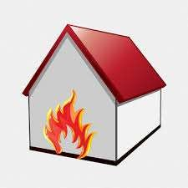
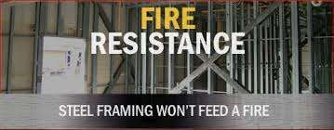
Check the buildings if they are resistant to fire. Since STEEL does not feed on fire, steel structured buildings would be more safer.

Slide 34




Hence, to construct any structure, first attain knowledge about the type you are going to construct, and also its safety measures.

